Slide 1
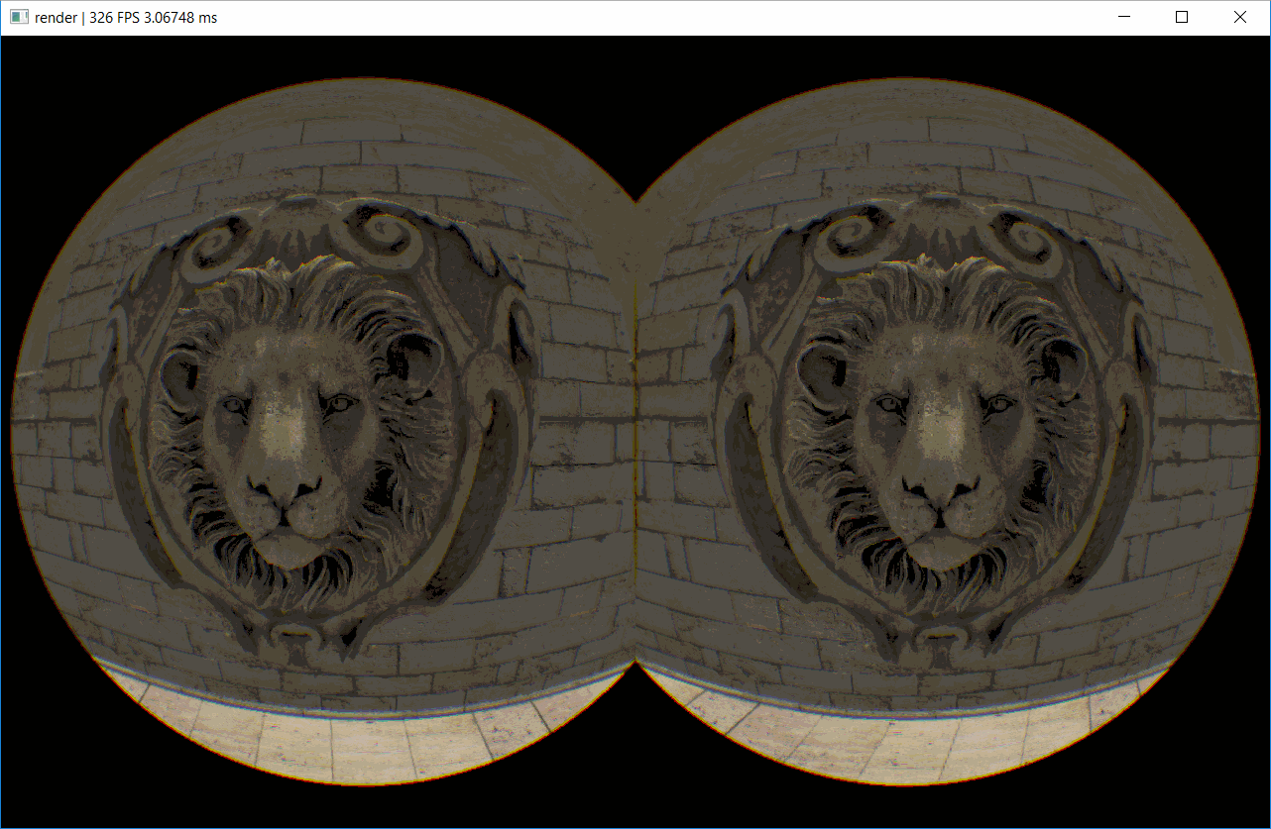
VR Simulation in Vulkan
Notes:
So this presentation will be about the paper “physically based simulation of rainbows”, it was dont in collaboration with UC san diego, university of zaragoza, some guy in horley UK, and disney research in sweden

Slide 2
Outline
VR Pipeline
VR Performance Techniques
Vulkan Considerations
Questions
Notes:
So for this talk, first I will talk about some of the fundamentals of rainbows, i.e. some rainbow jargon as well as why they appear the way they do
then I will talk about some of the previous approaches to simulating rainbows, including geometric optics and lorenz mie theory
Then we’ll get into this paper and its main contributions as well as it approach to simulating rainbows
And finally i will offer my own critique of how the paper presented the information and my overall impressions

Slide 3
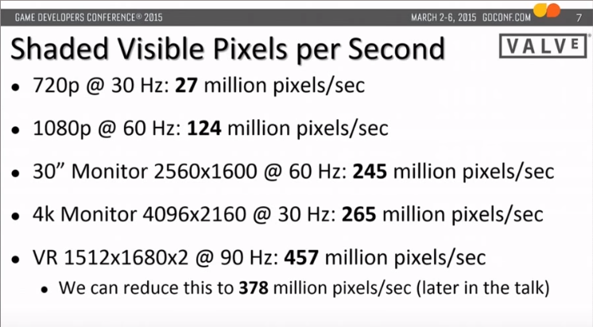
VR Optimizations Motivation
<- 95% of steam users, VR 3.7x more
2560x1600 @ 100 fps is a good benchmark to see if a game’s rendering performance is good enough for VR
Alex Vlachos GDC 2015 VR talk

Slide 4
VR Pipeline
Goal: Render each eye to their side of the screen.
Naive: go through entire pipeline twice
2x cost for view dependent items
Switch viewport and draw again
Massive context switch reduction
Only update viewport and camera no rebind of pipeline or object
Instanced Stereo Rendering
No longer 2x draw calls (use multi-viewport pipeline and instancing)
Up to 30% faster than naïve approach
Notes:
Identifying basic parts of the rainbow and how they are caused.
Primary bow: 1 internal reflection, violet on top, red on bottom. explained by geometric optics, snells law
Secondary bow: 2 internal reflections, more spread out, weaker in intensity, and flipped from primary. Violet on top red on bottwm Explained by geometric optics, snells law
Alexander’s dark band: no rain drops in the cloud are scattering light in that direction towards your eye
Supernumerary arcs faint ripples of mini rainbows trailing the violet side of the rainbow. This is an interference pattern we see as a result of light’s electric wave component
Twinned bow: non homogeneous rain drop shapes, need at least two different sizes where at least 1 is non-spherical

Slide 5
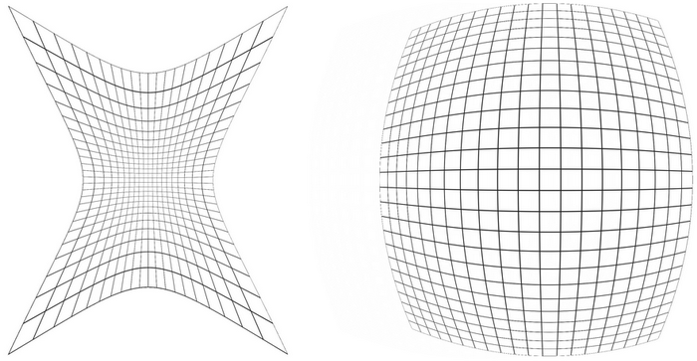
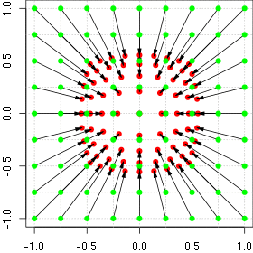
Barrel / Aberration
Barrel Distortion / Chromatic Aberration
Based on Brown-Conrady Model
Purpose is to counteract the distortion/refraction effects that happen to the 2D image as it goes through the lenses
Distortion is different per RGB (different constants per channel, get them from hmd vendor)
Arrows actually show direction of inverse

Slide 6
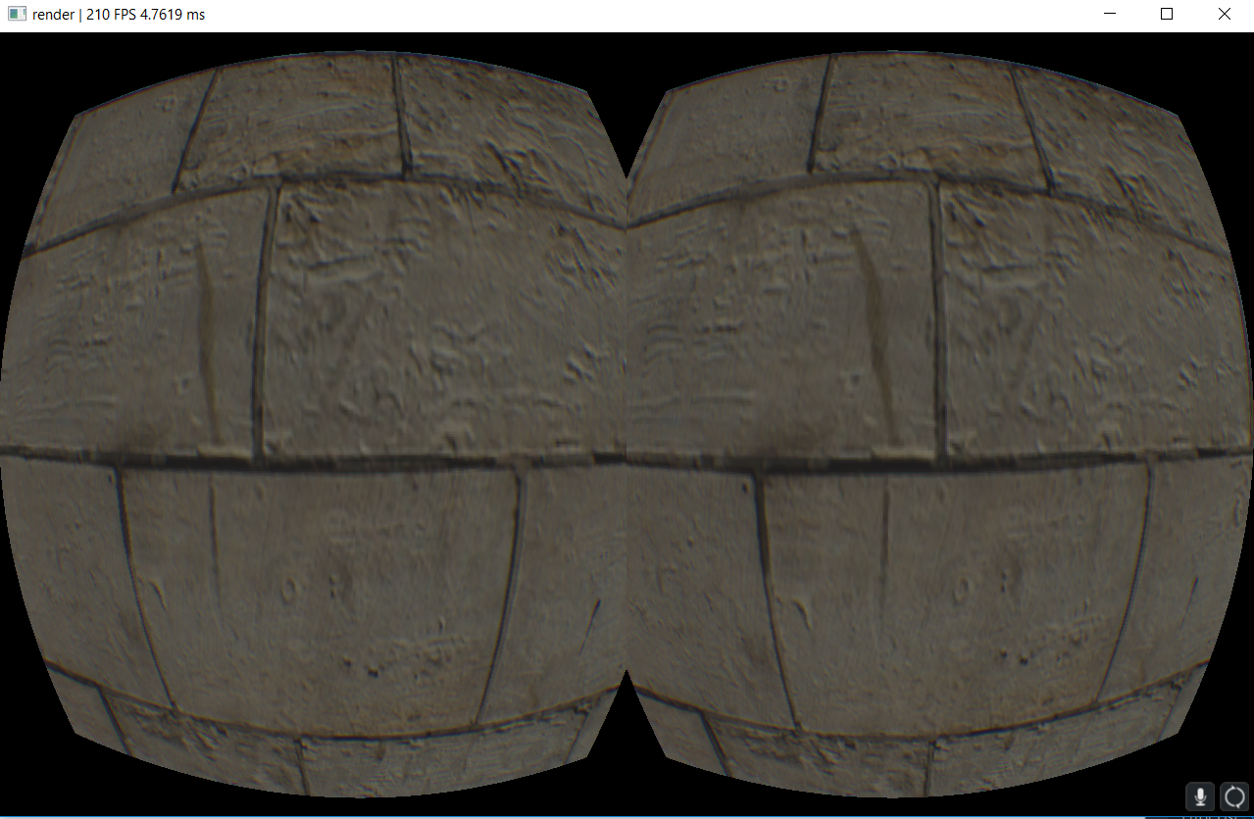
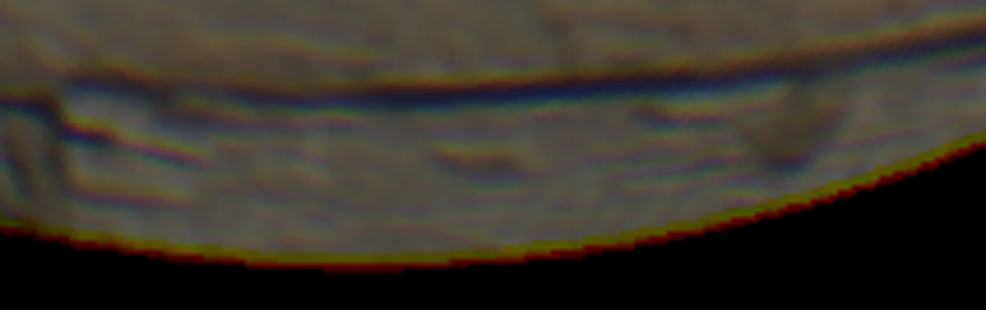
Barrel / Aberration (Fragment)
Draw a fullscreen triangle for each eye then every frag in the render target must call warping functions.
You pay a math + texture sample cost per pixel. Won’t scale as well as other methods (future gen. Hmd’s will keep increasing the res. of the panels)
(-1,-2), (0,-1)
Vulkan upper left
NDC is (-1,-1), UV(0,0)
(-1,1), (0, 1)
(2,1), (2,1)
Notes:
Lorenz Mie theory models light as a electromagnetic plane wave scattering through a homogenous sphere.
This paper will do the same but with non-spherical particles. This allows for more accurate simulation of rainbows.
Influences the shape of rainbow, and allows for simulation of twinned rainbows (believed to be caused by non-spherical rain drops).
Surace tension and air drag cause the rain to flatten as it falls through the air, the larger the particle the larger distortion to its shape.

Slide 7
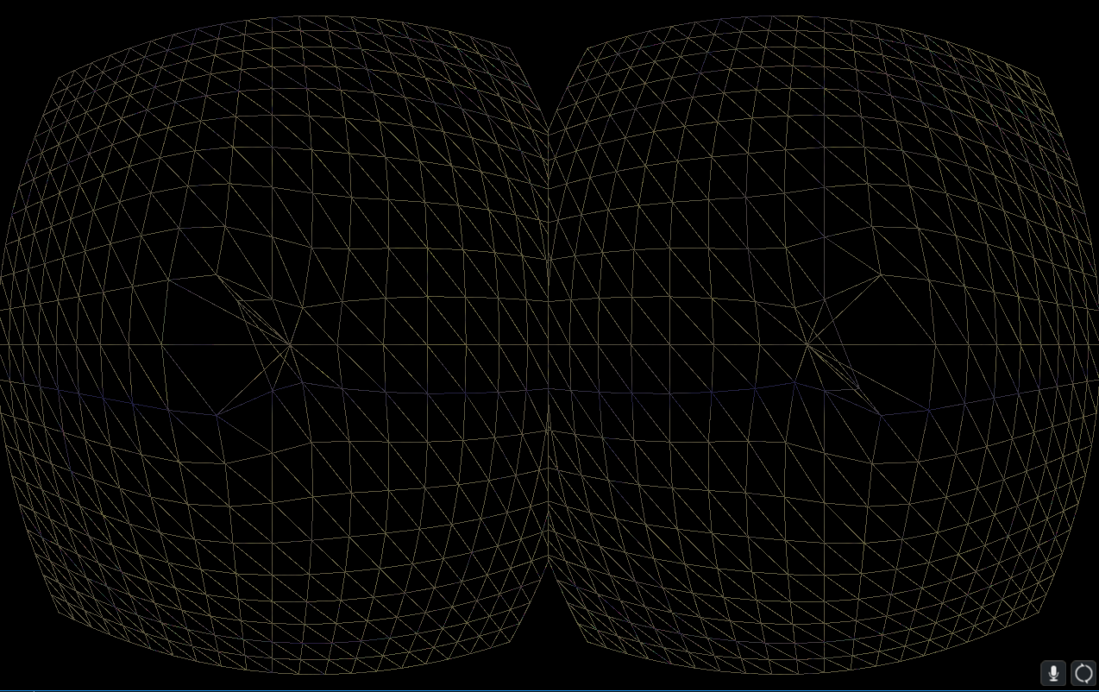
Barrel / Aberration (Vertex/Fragment)
Shrink the mesh down in the vertex shader (requires taking inverse of function using secant method).
Run distortion on fragments that were generated from the warped mesh. Less frags than previous method. Math + texture sample cost for each of those fragments
Notes:
Lorenz Mie theory models light as a electromagnetic plane wave scattering through a homogenous sphere.
This paper will do the same but with non-spherical particles. This allows for more accurate simulation of rainbows.
Influences the shape of rainbow, and allows for simulation of twinned rainbows (believed to be caused by non-spherical rain drops).
Surace tension and air drag cause the rain to flatten as it falls through the air, the larger the particle the larger distortion to its shape.

Slide 8
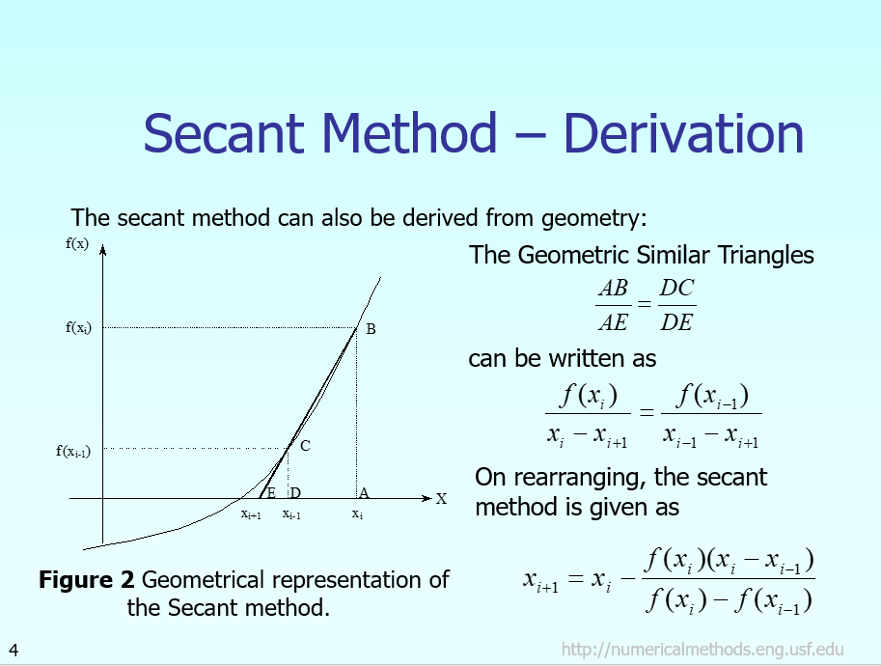
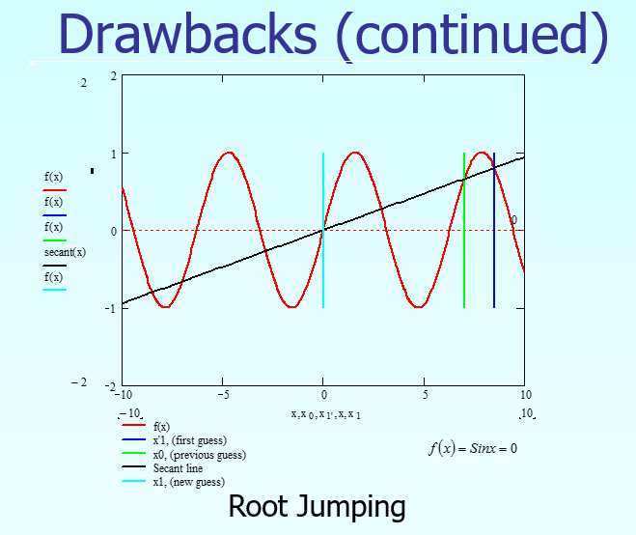
Inverse of Non-invertible function: Secant Method

Slide 9
Barrel / Aberration (Precompute)
Pre-distort a mesh that holds all the info we need. Pack color channel sampling UV’s in the vertex attributes.
Cost is just a texture sample for each fragment generated from the pre-warped mesh.
Brown-Conrady not linear, interpolation artifacts across boundaries of triangles in the mesh? Hard to tell if the mesh is dense enough.
Scales the best with future higher res hmd’s.
Notes:
Lorenz Mie theory models light as a electromagnetic plane wave scattering through a homogenous sphere.
This paper will do the same but with non-spherical particles. This allows for more accurate simulation of rainbows.
Influences the shape of rainbow, and allows for simulation of twinned rainbows (believed to be caused by non-spherical rain drops).
Surace tension and air drag cause the rain to flatten as it falls through the air, the larger the particle the larger distortion to its shape.

Slide 10
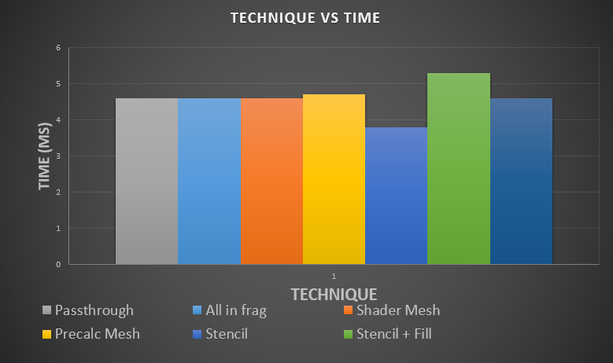
Barrel / Aberration (Compare)
End goal for VR: 16k per eye, 240fps (need greater than 1 petaflop, current needs are 8 teraflops)
The more you can shave off the constant post-processing overhead the better, so stick with precompute method.
Cost of a passthrough postprocess on 960m: 0.25ms, these can add up and eat away an already tiny margin (11.1ms: 10ms for rendering, give 1ms to OS for better stability/predictability)
Notes:
Lorenz Mie theory models light as a electromagnetic plane wave scattering through a homogenous sphere.
This paper will do the same but with non-spherical particles. This allows for more accurate simulation of rainbows.
Influences the shape of rainbow, and allows for simulation of twinned rainbows (believed to be caused by non-spherical rain drops).
Surace tension and air drag cause the rain to flatten as it falls through the air, the larger the particle the larger distortion to its shape.

Slide 11
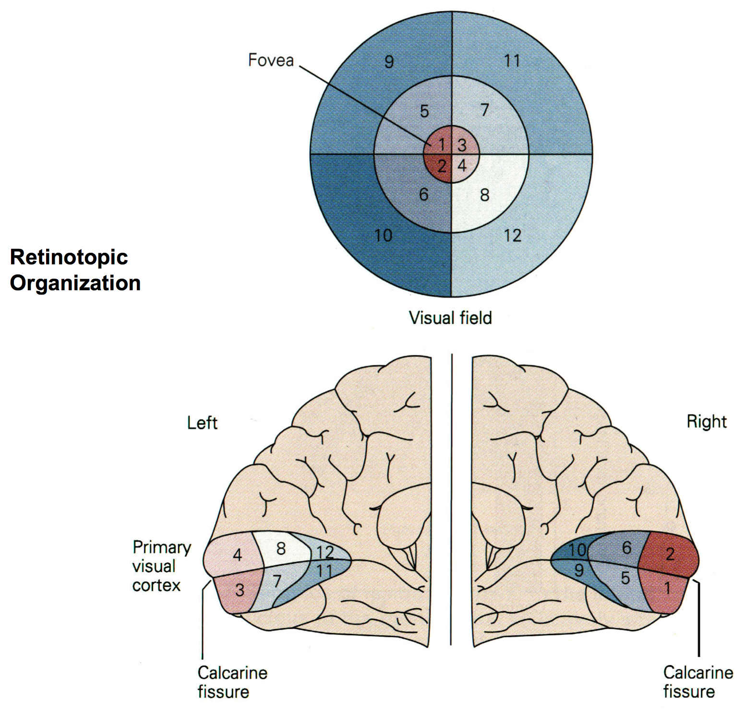
Shading Reduction Techniques
Radial Density Masking :
Most of our visual cortex is mapped to a small portion of our visual field. Don’t need periphery detail.
Uncomfortable to view at extreme angles(rather adjust head). Render the comfortable range at full res.
5 degrees of our field of view is all that is in focus at any one time (Microsoft Foveated Rendering)

Slide 12
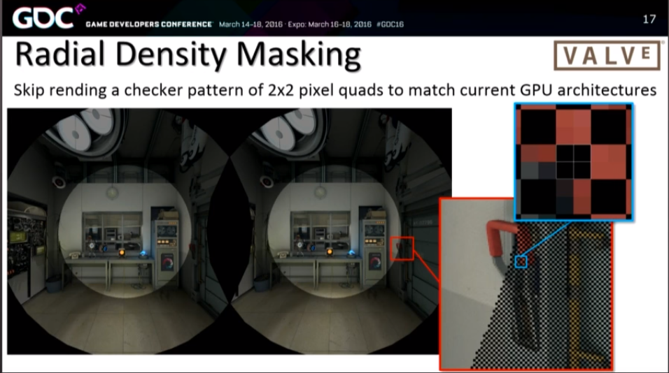
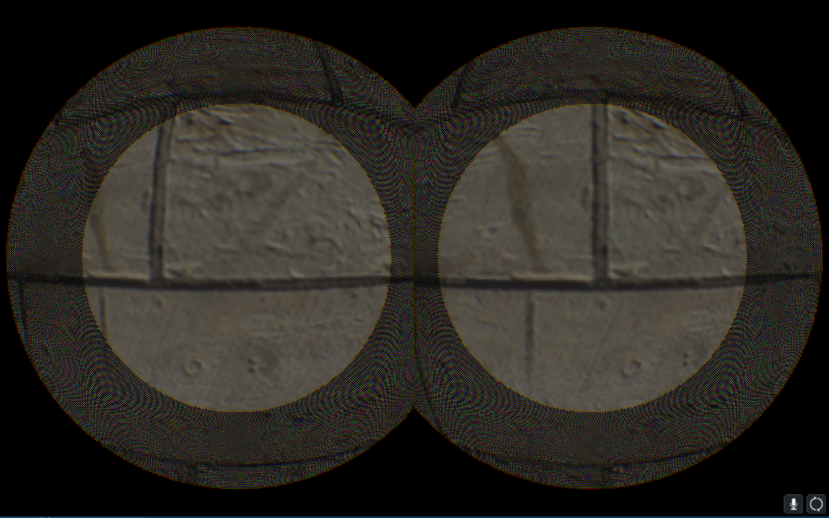
Shading Reduction Techniques
Radial Density Masking :
Render half the the pixel quads in the periphery
Over-rendering(barrel dist shrink-wraps periphery)
Render the comfortable view range at full res.
(Black) Don’t render portion of the screen that does not get picked up by refracted view direction
(Checker) skip 2x2 pixel quads in checker pattern and reconstruct in post process

Slide 13
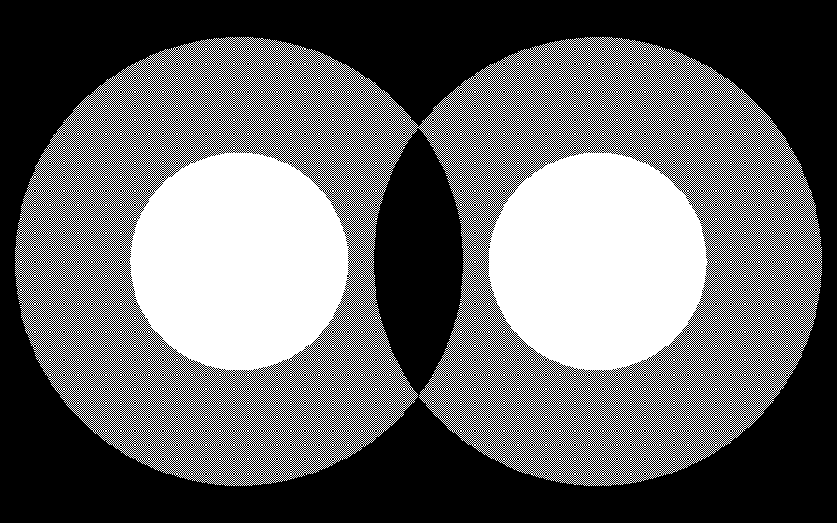
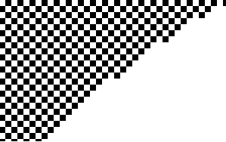
Shading Reduction Techniques
Radial Density Masking :
In vulkan, we can upload a pre-made mask into the stencil component of the depth stencil render target attachment.
White: frag shader executed.
Black: frag shader not executed

Slide 14
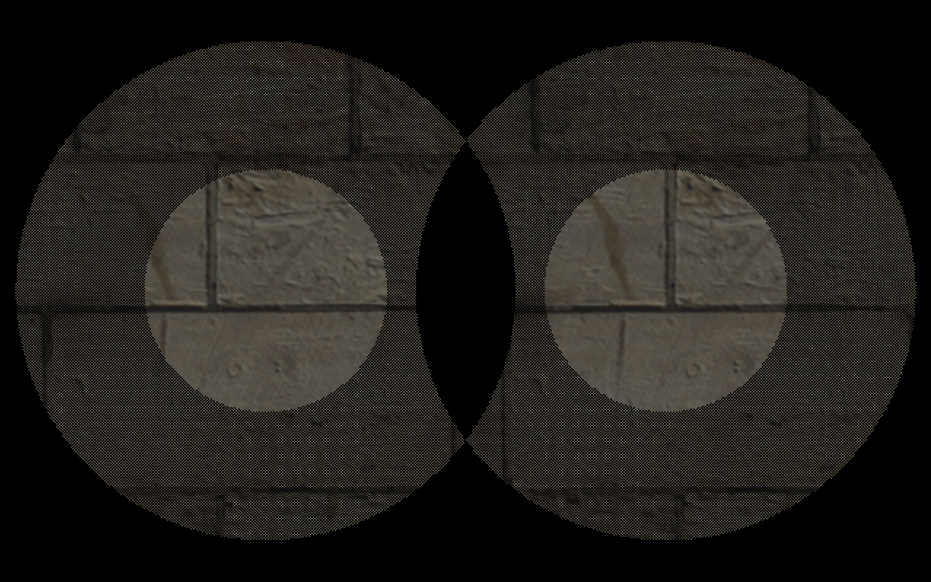
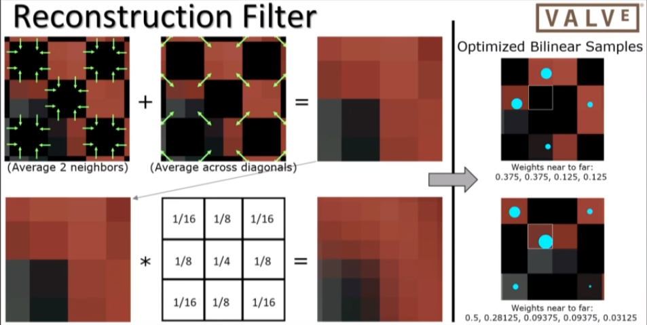
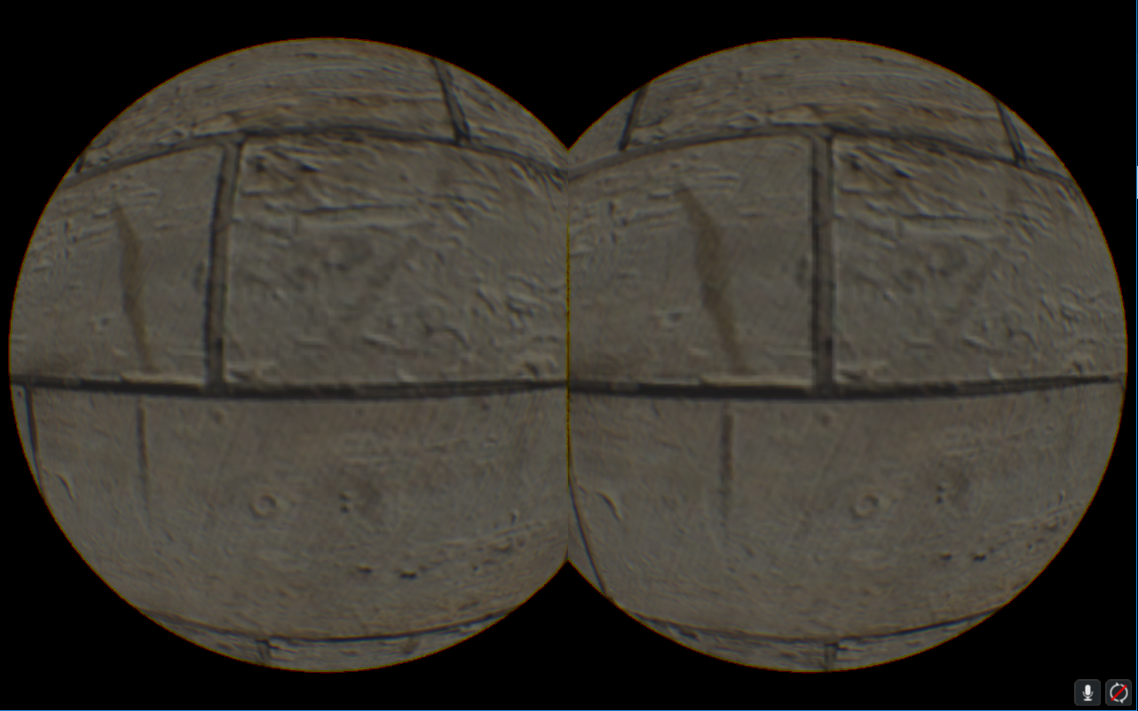
Shading Reduction Techniques
Radial Density Masking :
Similar to the goals for foveated rendering: don’t waste time shading the periphery.
Use bilinear sampling to reconstruct
Radial density draws once for each eye using premade stencil to skip pixel quads, then post process fills the holes.

Slide 15
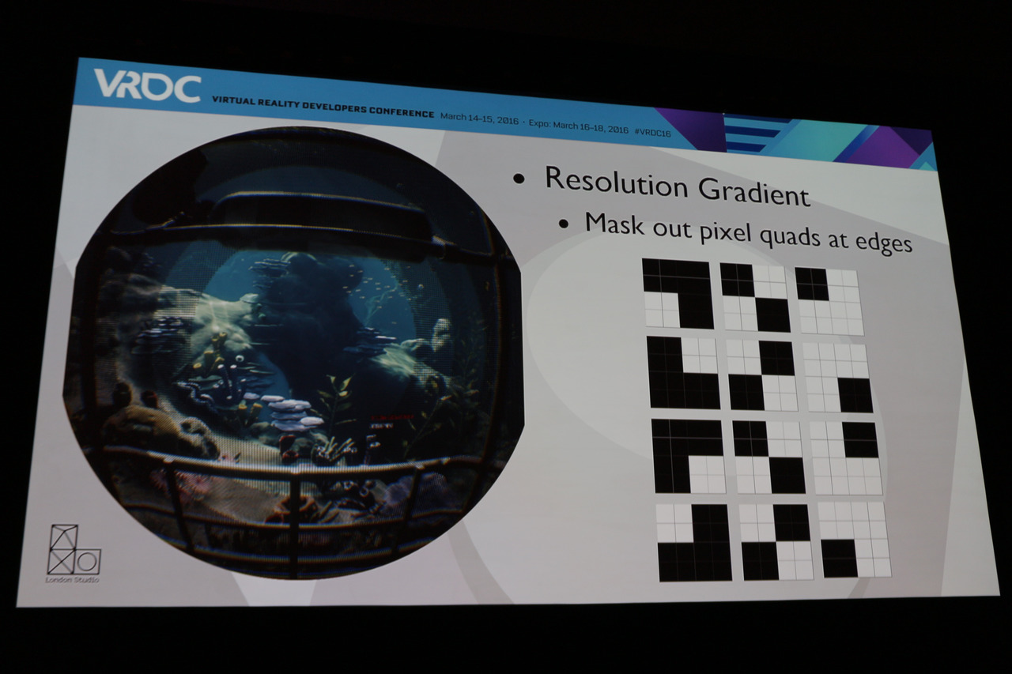
Shading Reduction Techniques
Radial Density Masking :
The more expensive your shading is, the more effective/valuable this becomes.
Rival: Fixed foveated: must draw more than 2 times: each eye for every res target. (Vendor extensions and modern hardware (900+) remove this need.)
Other stages of rendering must cater to the multi res style of fix foveated: deferred, ssao, post process, etc. Yuck.
Sony’s masking scheme

Slide 16
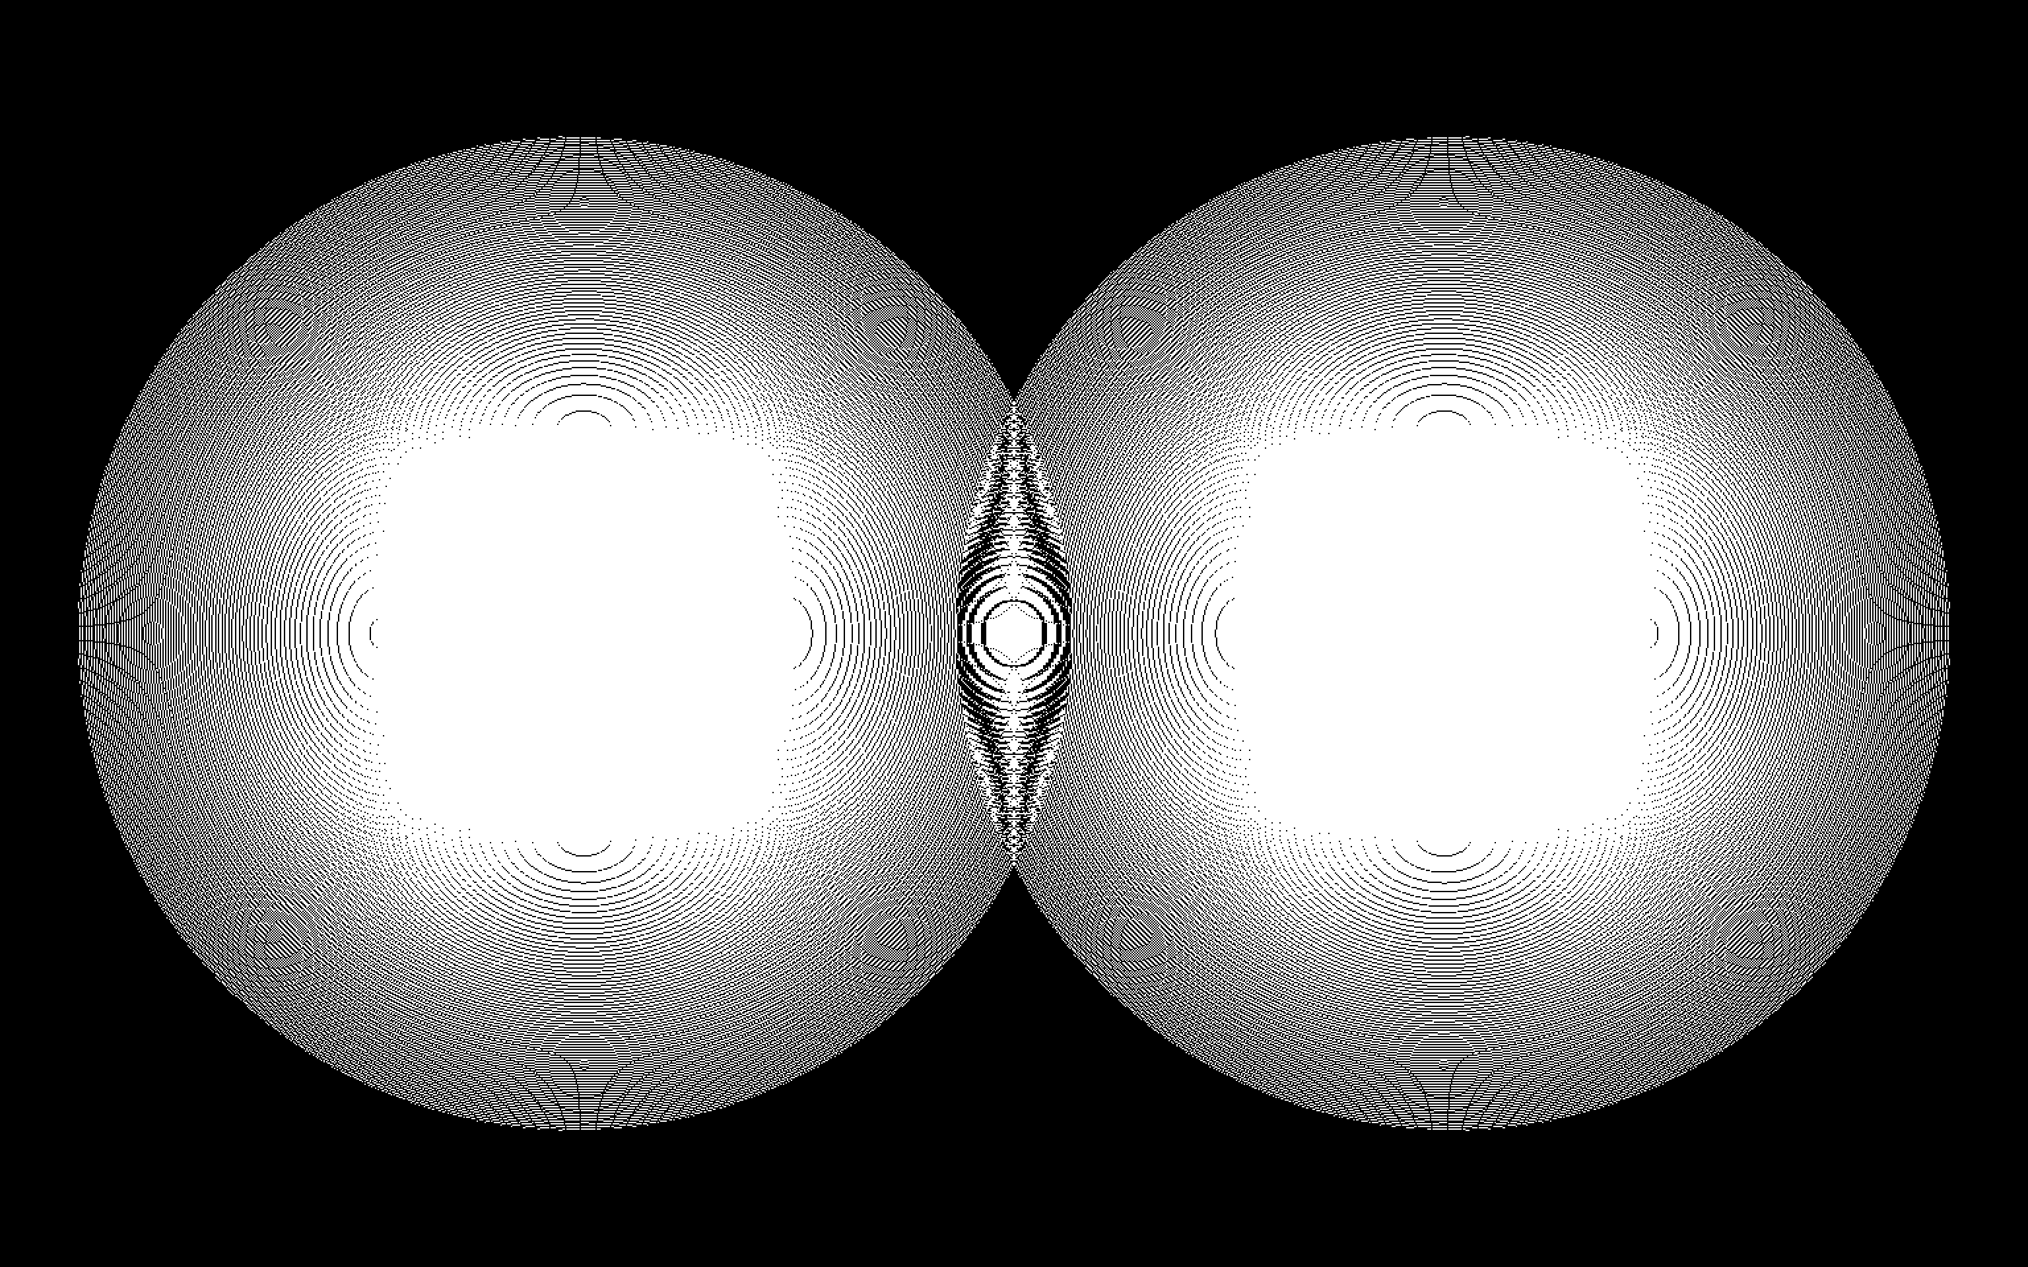
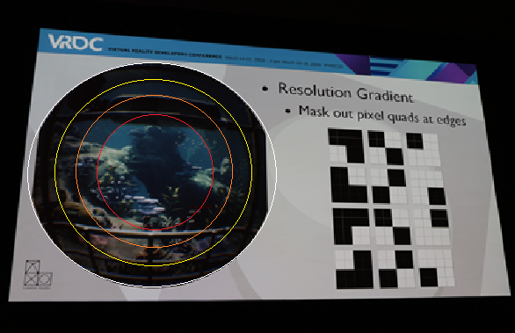
Radial Density Masking: Optimization Ideas
RDM – lends itself to cone-sphere frustum culling.
Use multiple cones for geom LOD/force mipmap level
Could precalculate a stencil mask that tags all the places from which barrel distortion will sample. Need wider screens and curvier optics to spread the barrel sampling far enough apart. Avoid image reconstruction step, barrel will sample from pixel quads dictated by precalc mask.
Current hmds are 110 fov, human vision is 210, still have room.

Slide 17
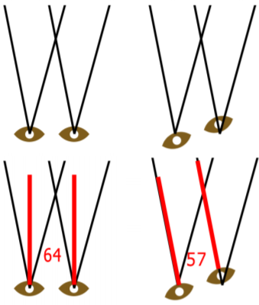
Shading Reduction Techniques
Adaptive Quality Filtering
Async Time and Space Warp should be used as infrequently as possible, still cause slight discomfort to the user.
Instead, predict when user is beginning to look towards an expensive view and reduce resolution.
Demo? Gif?

Slide 18
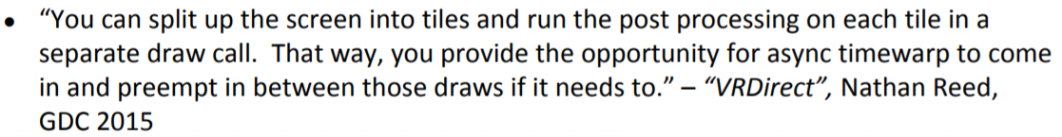
Time Warp: full implementation overview
Note on pre-emption: current GPU’s can only pre-empt on draw call boundaries, if scene drawing takes more than 11ms you wont be able to pre-empt, even if you’re using Nathan Reed’s workaround below.
If getting close to next vsync and haven’t finished rendering, pre-empt the gpu and warp last frame into the new view.
Constant overhead so we can calculate when that cutoff point is.
“Asynchronous” just means there’s a separate thread that monitors and does the pre-emption.
Notes:
Beard and Chuang model accounts for surface tension as well as hydrostatic pressure and aerodynamic pressure.
Start with the radius of our original perfect sphere at some angle theta then add the value returned by the Chebyshev polynomial series
Model describes the profile of the raindrop as when it reaches terminal velocity. Symmetrical about the up-axis
“A” is the radius of an equivalent volume perfect sphere.
Cn is found from the table, there are 8 of them
Theta is the angle between the up axis and the radius of our raindrop
Solving for the blue line
If we want a new row that specifies a different sized raindrop we can just linearly interpolate to get our coefficients
Hydrostatic pressure: The static (equilibrium) fluid pressure at a given depth does not depend upon the total mass, surface area, or the geometry of the container. Only on the height from the surface, gravity, and fluid density.

Slide 19
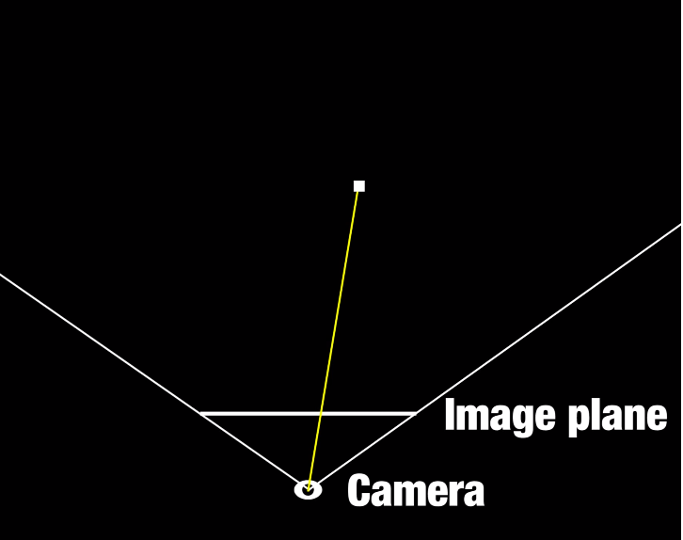
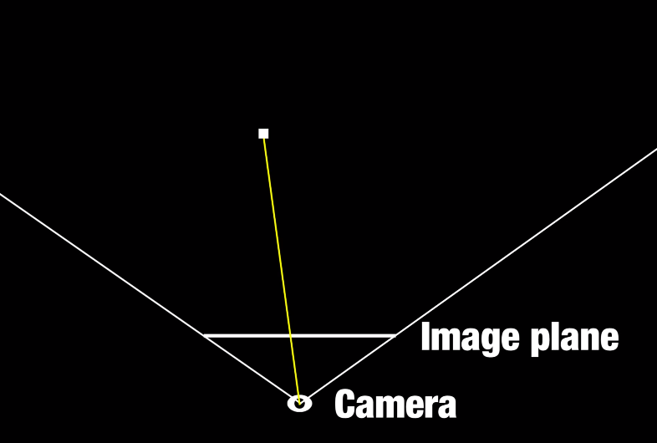
Time Warp
Warp last frame’s fragments back to world space using last frames depth buffer then warp them into current screen space.
Could pass in a rect of points, warp those and use orig. UV’s to sample prev. render target.
Points in any given region in prev. Render target will warp to same region in warped image: just use grid mesh.
Demo? Gif?
https://www.youtube.com/watch?v=WvtEXMlQQtI
Notes:
Beard and Chuang model accounts for surface tension as well as hydrostatic pressure and aerodynamic pressure.
Start with the radius of our original perfect sphere at some angle theta then add the value returned by the Chebyshev polynomial series
Model describes the profile of the raindrop as when it reaches terminal velocity. Symmetrical about the up-axis
“A” is the radius of an equivalent volume perfect sphere.
Cn is found from the table, there are 8 of them
Theta is the angle between the up axis and the radius of our raindrop
Solving for the blue line
If we want a new row that specifies a different sized raindrop we can just linearly interpolate to get our coefficients
Hydrostatic pressure: The static (equilibrium) fluid pressure at a given depth does not depend upon the total mass, surface area, or the geometry of the container. Only on the height from the surface, gravity, and fluid density.

Slide 20
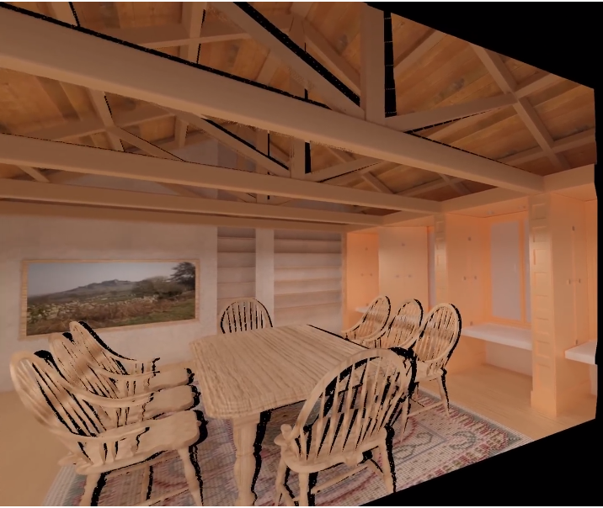
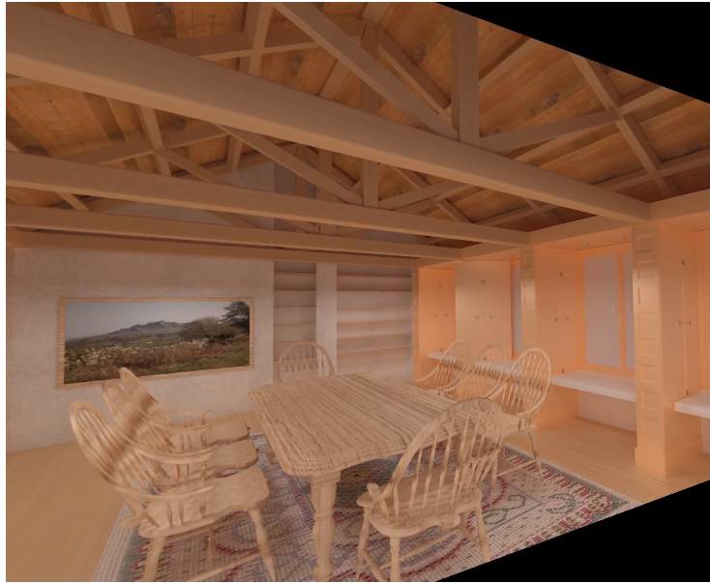
Time Warp: issues
Narrowing of the IPD, only rotation is updated.
If update position then disocculusion aartifacts appear.
Vlachos VR talk at GDC 2015
https://www.youtube.com/watch?v=WvtEXMlQQtI
Notes:
Beard and Chuang model accounts for surface tension as well as hydrostatic pressure and aerodynamic pressure.
Start with the radius of our original perfect sphere at some angle theta then add the value returned by the Chebyshev polynomial series
Model describes the profile of the raindrop as when it reaches terminal velocity. Symmetrical about the up-axis
“A” is the radius of an equivalent volume perfect sphere.
Cn is found from the table, there are 8 of them
Theta is the angle between the up axis and the radius of our raindrop
Solving for the blue line
If we want a new row that specifies a different sized raindrop we can just linearly interpolate to get our coefficients
Hydrostatic pressure: The static (equilibrium) fluid pressure at a given depth does not depend upon the total mass, surface area, or the geometry of the container. Only on the height from the surface, gravity, and fluid density.

Slide 21
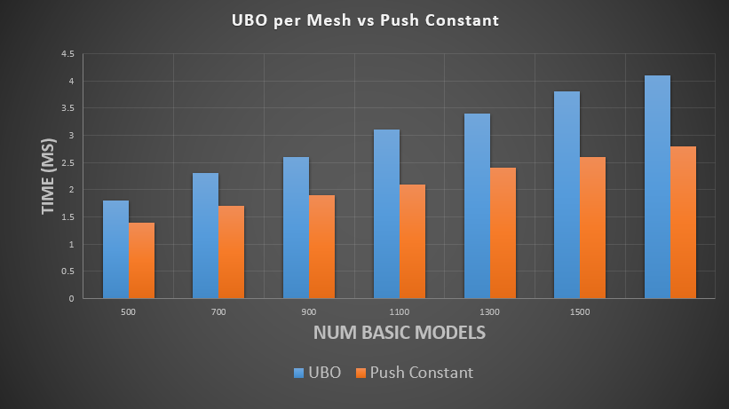
Vulkan Context Switch Reduction
Per object/Per draw state can be uploaded two ways: updating host-visible memory that is bound to a uniform buffer or push constants.
Host-visible memory update and transfer is slow
Can push the data during command recording. Guaranteed at least 128 bytes (equiv: 2 mat4’s).
Per frame data should be in a ubo, per draw data should be push constant

Slide 22
Vulkan Context Switch Reduction
Bunch of materials and shaders in your game, lots of context (shader) switching during scene draw.
Secondary buffer for each shader (and therefore, pipeline)
As you traverse scene you sift recording commands into the buffer associated with that shader
Secondary buffers will piggy back on a primary buffer that gets submitted to a queue
No secondary sift sort, just record directly into primary:
Secondary sift sort, record to secondary, attach to primary:

Slide 23
Vulkan Considerations
Secondary sift sort, record to secondary, attach to primary:
Viewport switching is ‘zero cost’ according to Nvidia.
During draw command recording for an object, sneak in some extra data (128 bytes min support)with push constants instead of submitting another command buffer to update part of the uniform buffer.
Specialization constants can determine a path in a shader that the pipeline will take. Path determined at pipeline creation. Need to rebind pipeline vs sending bit-mask PC
Update UBO
Slip in data with PC
VS

Slide 24
Questions
VR pipeline organization
Barrel/chromatic aberration opt
Radial Density masking (and possible opt)
Adaptive Quality Filtering
Time warp simulation
Vulkan Considerations:
UBO vs Push Constant
Dynamic Viewport switching
Specialization constants vs push constants

